Slide 1
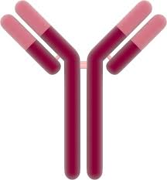
Assessing the Identifiability of Models for Monoclonal Antibody Target Mediated Drug Disposition Using a New Metric of Potency
Drug
Target
Complex
+
t1/2 ≈ 21d
t1/2 ≈ 1h
t1/2 ≈ 21d
Andy Stein, Prasad Ramakrishna
Pharmacometrics, Novartis - July 13, 2016

Slide 2
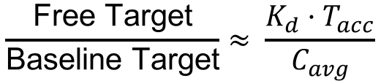
Overview
Introduction to monoclonal antibody drugs.
Present model for describing kinetics of monoclonal antibody drug and its target
Analyze mathematical model to
1) Identify nondimensional potency factor for target inhibition
2) Assess the identifiability of the model
$$\frac{\text{Free} \text{Target}}{\text{Baseline} \text{Target}}≈ \frac{K_{d}·T_{acc}}{C_{avg}}$$

Slide 3
Introduction

Slide 4
Monoclonal Antibodies with Soluble Targets
Total Target Assay
Measures both free and bound target
Drug
Target
Complex
+
t1/2 ≈ 21d
t1/2 ≈ 1h
t1/2 ≈ 21d*
Binding neutralizes the target
* Drug and complex do not necessarily have the same half-life

Slide 5
Drug Pharmacokinetics for 150 mg monthly subcutaneous dosing
Drug Conc.

Slide 6
Target accumulation is 200x and drug is in vast excess to its target.
Drug Conc.
150 nM = 22 μg/ml Cmin
for 150 mg Drug
15,000:1
Target
0.01 nM (Post-dose steady state target)
200x accumulation
5×10⁻⁵ nM (Baseline target conc.)
Notes:
Even if only 0.1% of target is free at 150mg dose regimen,
the 200x accumulation means that free IL-17 has only been reduced by 20% compared to baseline
(0.1% × 200 = 20%)

Slide 7
Target accumulation is similar for both 150 mg and 300 mg
Drug Conc.
150 nM = 22 μg/ml Cmin
for 150 mg Drug
15,000:1
Target
0.01 nM (Post-dose steady state target)
200x accumulation
5×10⁻⁵ nM (Baseline target conc.)
Question: What would you predict for efficacy?

Slide 8
Greater efficacy is observed at 300 mg vs 150 mg Why?
Total Target Data
Similar for 150 mg and 300 mg
PASI² 90 Efficacy Metric
Superior for 300 mg
300 mg
Conc. (nM)
150 mg
Week
Week

Slide 9
mathematical Model of Drug-target binding

Slide 10
The PK-binding model
Dose
k_{syn}
k₁₂
k_{on}
Drug-Periph (D_{P})
Drug (D)
+
Target (T)
Complex (DT)
k₂₁
k_{off}
k_{eD}
k_{eT}
k_{eDT}
Assumption: Target binding and synthesis in the peripheral compartment.
This assumption is made out of convenience: data is not rich enough to identify additional peripheral parameters.

Slide 11
The PK-binding model equations
Dose
k_{syn}
k₁₂
k_{on}
Drug-Periph (D_{P})
Drug (D)
+
Target (T)
Complex (DT)
k₂₁
k_{off}
k_{eD}
k_{eT}
k_{eDT}
Dose or Synthesis
Elimination
Binding
Distribution
Not all parameters of this model are identifiable.
We only measure total target, which is the sum: T_{tot} = T + DT

Slide 12
The Quasi-Equilibrium Assumption
Assumption: binding is rapid such that drug, target, and complex stay in equilibrium.
This assumption allows us to reduce number of state variables from four [D, T, DT, D_{P}] to three [D_{tot}, T_{tot}, D_{P}] plus an algebraic set of equations

Slide 13
The Quasi-Equilibrium Model Binding only occurs in central compartment
Dose
k_{syn}
k₁₂
K_{d}
Drug-Periph (D_{P})
Drug (D)
+
Target (T)
Complex (DT)
k₂₁
k_{eD}
k_{eT}
k_{eDT}
Dose or Synthesis
Elimination
Distribution
Concentrations D, T, and DT are solved for using
algebraic binding equations

Slide 14
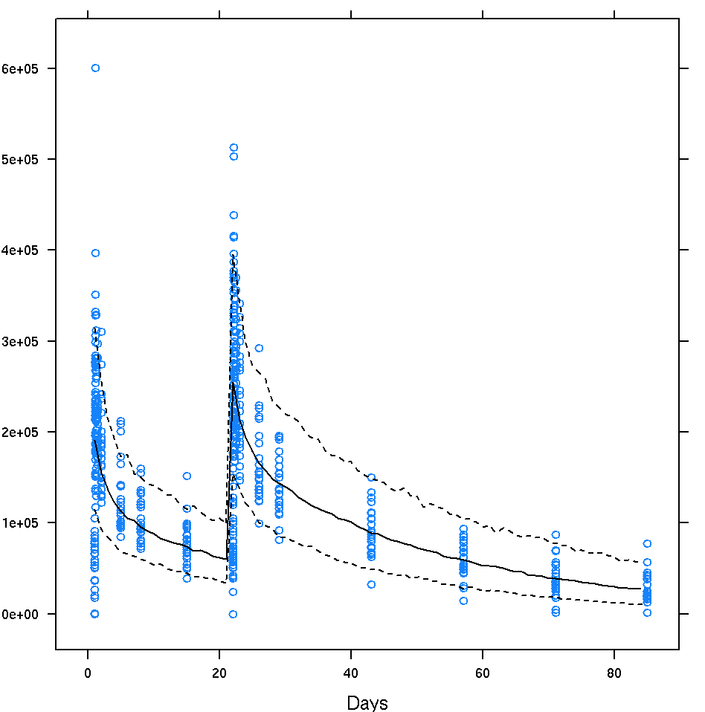
Model fit to drug PK and target accumulation data
Drug Concentration
(700 mg iv dosing)
Total Target Concentration
(subcutaneous dosing)
60
50
40
30
20
10
0
Conc. (ng/ml)
700 mg
150 mg
0 3 6 9 12
Time (Weeks)
14
Model can be used to:
1) Describe available PK and total target data.
2) Predict free target concentration

Slide 15
Sensitivity analysis: total target plateaus, but free target continues to decline with dose
subcutaneous
dosing
150 mg
27% free
300 mg
14% free
2 compartment linear PK with subcutaneous absorption
Above 150 mg, total target concentration plateaus (measurable)
Above 150 mg, every 2x dose increase leads to 2x free target decrease (predicted)

Slide 16
mathematical analysis of drug-target model

Slide 17
Key Quantity of Interest: Free Target vs Baseline
1) Free Target
vs Total Target
2) Total Target
Accumulation

Slide 18
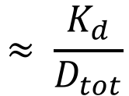
Calculating Free Target vs Total Target
1) Free Target
vs Total Target
Algebraic manipulation of quasi-equilibrium equation
$$≈ \frac{K_{d}}{D_{tot}}$$
When Dtot >> Ttot, Kd

Slide 19
Analysis of total target dynamics before dosing
Before Dose, DT=0
At steady state: dT_{tot}/dt = 0

Slide 20
Analysis of total target dynamics after dosing
2) Total Target
accumulation
For large drug conc.,
most target is bound,
T ≈ 0, and DT ≈ T_{tot}
T_{tot}
At steady state: dT_{tot}/dt = 0
T_{acc}

Slide 21
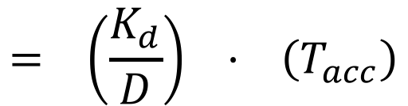
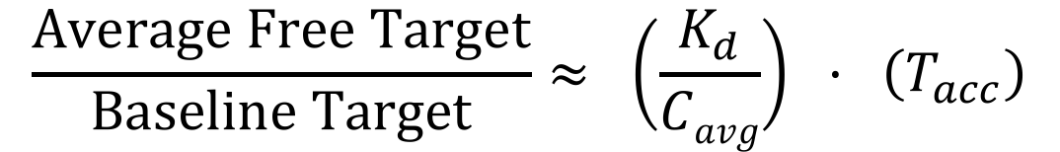
Estimating the free target compared to baseline
$$= \left(\frac{K_{d}}{D}\right) · \left(T_{acc}\right)$$
$$\frac{Average Free Target}{Baseline Target}≈ \left(\frac{K_{d}}{Cavg}\right) · \left(T_{acc}\right)$$

Slide 22
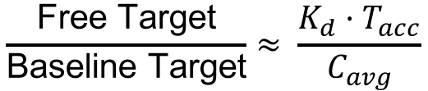
Summary
$$\frac{\text{Free} \text{Target}}{\text{Baseline} \text{Target}}≈ \frac{K_{d}·T_{acc}}{C_{avg}}$$
Three key parameters determine target inhibition when there is a large excess of drug relative to target at steady state.
Binding affinity (K_{d})
Target accumulation factor (T_{acc})
Drug concentration (C_{avg})
In these circumstances, doubling dose, halving dosing interval, or halving K_{d} reduces free target by 50%
At high doses, total target reaches plateau. This does not mean target inhibition has reached plateau

Slide 23
Analysis of total target kinetics

Slide 24
Target dynamics is characterized by 4 parameters
Dose
k_{syn}
k₁₂
K_{d}
Drug-Periph (D_{P})
Drug (D)
+
Target (T)
Complex (DT)
k₂₁
k_{eD}
k_{eT}
k_{eDT}
To understand identifiability, it’s useful to reparameterize:
T₀ = k_{syn}/k_{eT}
T_{totss} = k_{syn}/k_{eDT}
k_{eDT}
K_{d}
dT_{tot}/dt ≈ k_{syn} – k_{eDT}·T_{tot}
T_{tot} ≈ T₀ + (T_{tot,ss}-T₀)·exp[-k_{eDT} · t]
for large drug concentrations

Slide 25
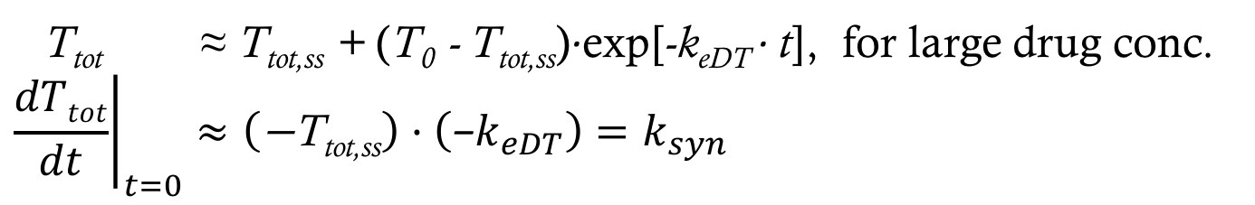
Understanding the total target dynamics
T_{tot} ≈ T_{tot,ss} + (T₀ - T_{tot,ss})·exp[-k_{eDT} · t], for large drug conc.
$${\left.\frac{dTtot}{dt}\right|}_{t=0}≈\left(\text{−}\text{T}\text{tot}\text{,}\text{ss}\right)·\left(\text{−}k_{eDT}\right)=k_{syn}$$
Dose/Kd (mg/nM)
T_{totss}
k_{syn}
T₀

Slide 26
Identifiability – free target inhibition can be predicted even if baseline target is not measurable
Assay may not be sensitive enough to measure T0.
In that case, only three parameters may be identifiable:
k_{eDT}, T_{totss}, and T₀/K_{d}
Note that free target inhibition (T/T₀) depends on the ratio T₀/K_{d}
T/T₀ = K_{d}·T_{acc}/C_{avg}
= (K_{d}/T₀)·T_{totss}/C_{avg}
Varying T0,
keeping T0/Kd fixed

Slide 27
Free target inhibition can be predicted even if complex elimination (keDT) is not identifiable
k_{eDT} is also not identifiable if sufficient samples are not taken.
But T/T₀ can still be estimated
T/T₀ = K_{d}·T_{acc}/C_{avg}
= (K_{d}/T₀)·T_{totss}/C_{avg}
T_{totss}
k_{eDT}
T₀
~Dose·T0/Kd

Slide 28
Summary
$$\frac{\text{Free} \text{Target}}{\text{Baseline} \text{Target}}≈ \frac{K_{d}·T_{acc}}{C_{avg}}$$
Three key parameters determine target inhibition when there is a large excess of drug relative to target at steady state.
Binding affinity (K_{d})
Target accumulation factor (T_{acc})
Drug concentration (C_{avg})
In these circumstances, doubling dose, halving dosing interval, or halving Kd reduces free target by 50%
At high doses, total target reaches plateau. This does not mean target inhibition has reached plateau
Free target inhibition is estimable even when baseline target (T₀) or rate of complex elimination (k_{eDT}) are not estimable.

Slide 29
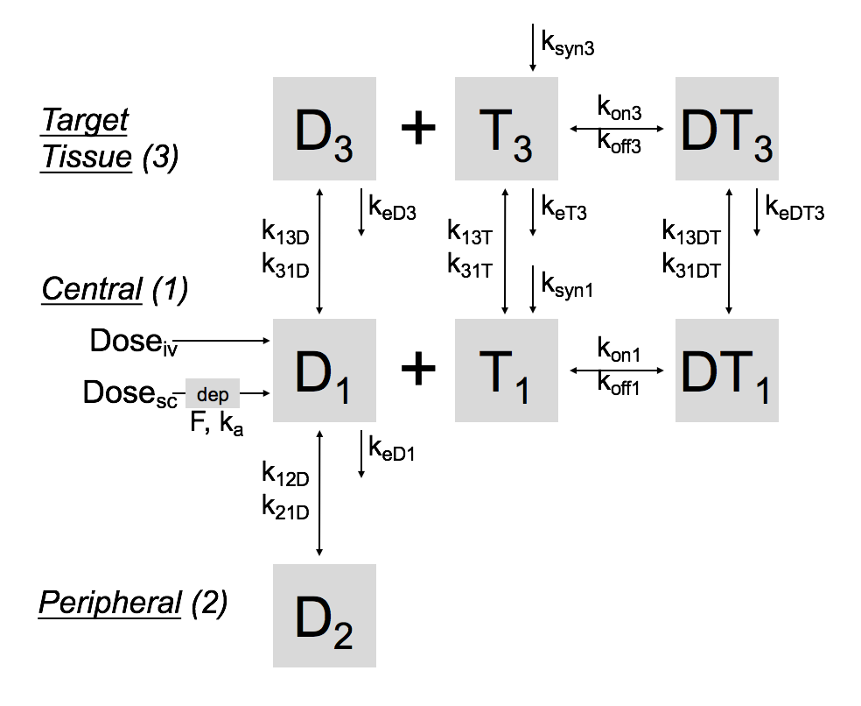
Limitations
This analysis focused on inhibition in blood. Inhibition in tissue is more challenging to measure and predict.
This analysis only applies when drug is in vast excess to target (not applicable for anti-C5, where C5 ≈ 500 nM)

Slide 30
Acknowledgements
Brian Stoll
Gerard Bruin
Irina Koroleva
Frank Kolbinger
Max Woisetschlaeger
Henning Schmidt
Jean-Louis Steimer
Phil Lowe
Mick Looby
Karthik Subramanian
Bruce Gomes
Wenping Wang

